Slide 1

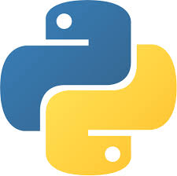
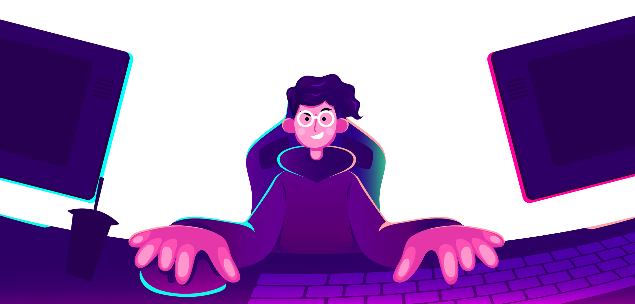
AI Master Class series – Day 4
Real-time Moving Object detection & Tracking

Slide 2
Announcement
Attendance link will be available around
8:30 PM.

Slide 3
Day-3 Agenda.
01.
02.
03.
Moving Object detection
Basic CV Program
Moving Object detection
Moving object detection & its application
Resize, Thresholding, Gaussian Blur for an Image
Python Program

Slide 4
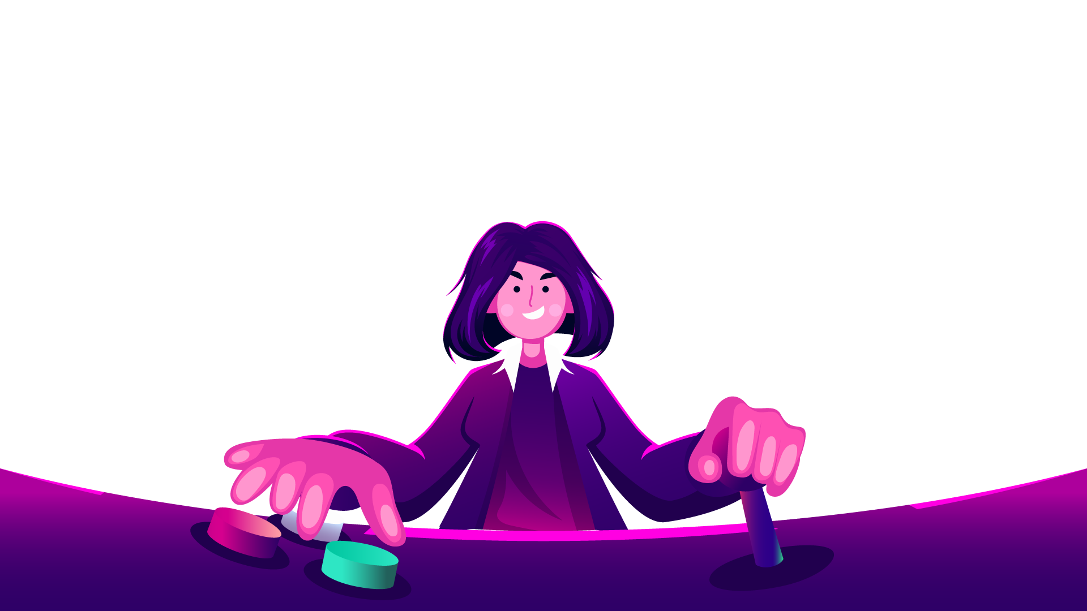
Moving Object Detection.
Moving object detection is a technique used in computer vision and image processing. Multiple consecutive frames from a video are compared by various methods to determine if any moving object is detected.

Slide 5

Practical session

Slide 6
Image Resize.
import cv2
import imutils
img = cv2.imread(‘sample2.jpg')
resizedImg = imutils.resize(img, width=500)
cv2.imwrite(‘resizedImage.jpg', resizedImg)

Slide 7
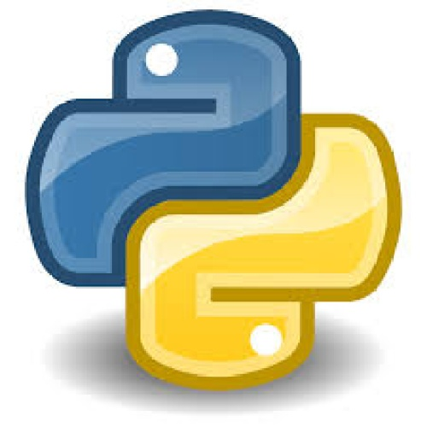

Gaussian Blur - Smoothening.
import cv2
img = cv2.imread(‘sample2.jpg')
grayImg = cv2.cvtColor(img, cv2.COLOR_BGR2GRAY)
#dst = cv2.GaussianBlur(src, (kernel),borderType)
gaussianImg = cv2.GaussianBlur(grayImg, (21, 21), 0)
cv2.imwrite(“GaussianBlur.jpg”, gaussianImg)

Slide 8
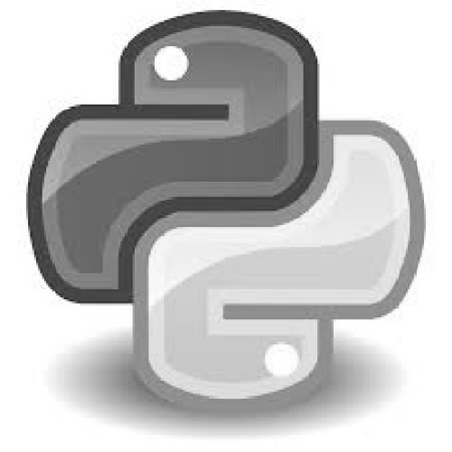
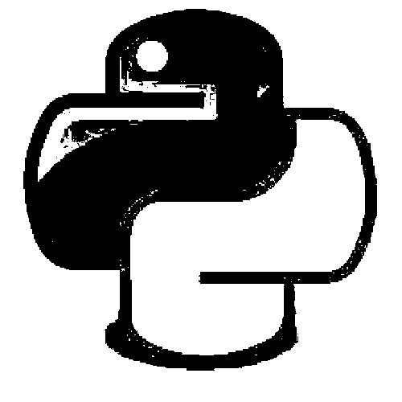
threshold.
#dst = cv2.threshold(src, threshold, maxValueForThreshold,binary,type)[1]
import cv2
img=cv2.imread("sample.jpg")
grayImg = cv2.cvtColor(img,cv2.COLOR_BGR2GRAY)
gaussBlur = cv2.GaussianBlur(grayImg,(21,21),0)
thresholdImg = cv2.threshold(grayImg,150,255,cv2.THRESH_BINARY)[1]
cv2.imwrite("threshold.jpg",thresholdImg)

Slide 9
Drawing Rectangle.
#cv2.rectangle(src,startpoint,endpoint,color,thickness)
cv2.rectangle(img, (x, y), (x + w, y + h), (0, 255, 0), 2)
Putting Text in Image.
#cv2.putText(src, text, position,font,fontSize,color,thickness)
cv2.putText(img, text, (10, 20), cv2.FONT_HERSHEY_SIMPLEX, 0.5, (0, 0, 255), 2)

Slide 10
findContours.
#dst =cv2.findContours(srcImageCopy, contourRetrievalMode,
contourApproximationMethod)
cnts = cv2.findContours(threshImg.copy(), cv2.RETR_EXTERNAL,
cv2.CHAIN_APPROX_SIMPLE)

Slide 11
Reading frame from camera – video streaming.
import cv2
vs = cv2.VideoCapture(0)
while True:
_,img = vs.read()
cv2.imshow("VideoStream", img)
key = cv2.waitKey(1) & 0xFF
if key == ord("q"):
break
vs.release()
cv2.destroyAllWindows()

Slide 12
Moving Object detection.
import imutils
import time
import cv2
vs = cv2.VideoCapture(0)
firstFrame = None
area=500

Slide 13
while True:
_,img = vs.read()
text = "Normal"
img = imutils.resize(img, width=500)
grayImg = cv2.cvtColor(img, cv2.COLOR_BGR2GRAY)
grayImg = cv2.GaussianBlur(grayImg, (21, 21), 0)
if firstFrame is None:
firstFrame = grayImg
continue
imgDiff = cv2.absdiff(firstFrame, grayImg)
threshImg = cv2.threshold(imgDiff, 25, 255, cv2.THRESH_BINARY)[1]
threshImg = cv2.dilate(threshImg, None, iterations=2)
cnts = cv2.findContours(threshImg.copy(), cv2.RETR_EXTERNAL,
cv2.CHAIN_APPROX_SIMPLE)
cnts = imutils.grab_contours(cnts)
for c in cnts:
if cv2.contourArea(c) < area:
continue
(x, y, w, h) = cv2.boundingRect(c)
cv2.rectangle(img, (x, y), (x + w, y + h), (0, 255, 0), 2)
text = "Moving Object detected"
print(text)
cv2.putText(img, text, (10, 20),
cv2.FONT_HERSHEY_SIMPLEX, 0.5, (0, 0, 255), 2)
cv2.imshow("VideoStream", img)
cv2.imshow("Thresh", threshImg)
cv2.imshow("Image Difference", imgDiff)
key = cv2.waitKey(1) & 0xFF
if key == ord("q"):
break
vs.release()
cv2.destroyAllWindows()

Slide 14
Q & A session

Slide 15
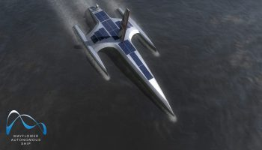
AI News – Day 4. SEP-2020
A(I)hoy, mateys: IBM’s crewless ocean research ship to launch ‘very soon’
IBM’s crewless AI-powered ship is due to begin roaming the oceans this month, collecting vital data about something we still know incredibly little about.

Slide 16
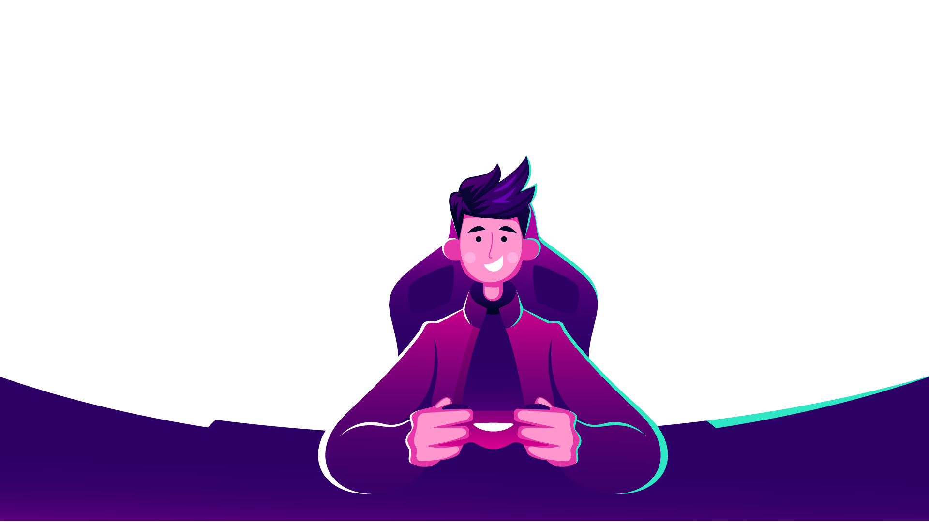
Thanks!
Tomorrow session
Do you have any questions?
sanjay@pantechmail.com
www.pantechsolutions.net
Real-time Face Detection and Tracking

